Slide 1
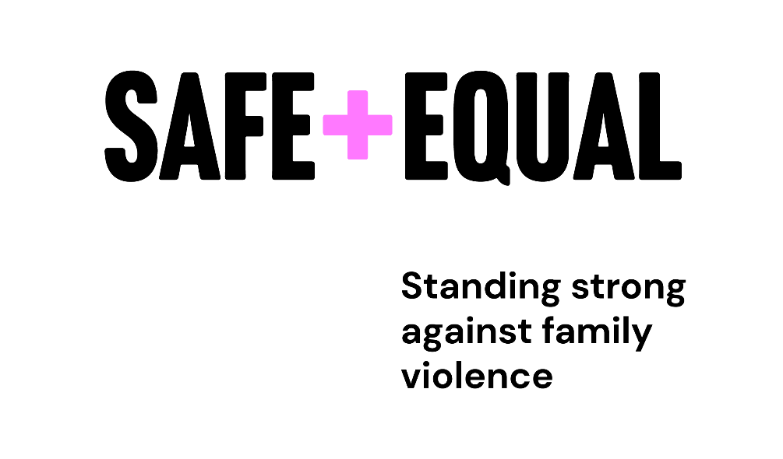
Renting and Family Violence
Kimberley Hay and Courtney Wamala

Slide 3
About Safe and Equal
Safe and Equal is the peak body for specialist family violence services that provide support to victim survivors in Victoria. We are an independent, non-government organisation that leads, organises, advocates for, and acts on behalf of our members – with a focus across the continuum from primary prevention through to response and recovery.
We work towards a world beyond family and gender-based violence, where women, children and all people from marginalised communities are safe, thriving and respected.

Slide 4
Impacts of Family Violence

Slide 5
Impacts of family violence on housing
Family violence is a leading cause of homelessness in Victoria, particularly for women and young people (Parliament of Victoria, 2021, p. xxi).
Complex risk & safety factors that have consequences for a victim-survivor’s housing.
Cycle of homelessness as a result of experiencing family violence is common.
Creating an environment where victim-survivors can stay safely in their rental property.

Slide 6
Safe at Home
Supports victim-survivors to safely remain in their current property, while the perpetrator leaves
Preferred housing response to family violence
Safe at Home is a variety of system responses, including:
Interventions with perpetrators
Justice responses
Case management support
Safety modifications and technologies (e.g. security doors, home alarms)
Must be risk and safety informed

Slide 7
Brokerage

Slide 8
Brokerage Available
CRITERIA | PROGRAMS
 | Flexible Support Packages | Family Violence Crisis Brokerage | Escaping Violence Payment | The Orange Door Brokerage | Red Cross Family and Domestic Violence Financial Assistance
Available to all Victim Survivors | ✓ | ✓ | X | ✓ | X
Case management required | ✓ | ✓ | X | X | X
Self-referral available | X | X | ✓ | ✓ | ✓
Need to be engaged with Specialist Family Violence Service | X | ✓ | X | X | X
Need to be engaged with that specific service | X | X | X | ✓ | X

Slide 9
What Brokerage Can Pay For
The following items are examples of what brokerage can pay for:
Safety and security items
Education costs
Housing costs (rent in advance, rent arrears, mortgage payments)
Furniture
Removal costs
Legal fees

Slide 10
Personal Safety Initiative

Slide 11
Personal Safety Initiative
Provides safety and security measures to enable a victim survivor to remain in the home.
Available to victim survivors who have experienced family violence, no longer reside with the perpetrator, have a full IVO in place and are eligible for a Flexible Support Package.
Through the completion of a safety and security audit on the home, security modifications are recommended to enhance the safety and security of the property.
Some safety and security items can be installed prior to or without a safety and security audit being conducted; these include repairs to windows, lock changes and security doors.

Slide 12
Safety and Security Modifications
Safety and security modifications include but are not limited to:
CCTV
Sensor lighting
Security doors
Personal Safety Devices
Tech sweeps
Bug sweeps
Dash cams
Foliage trimming
Fence extensions
Brokerage for safety and security modifications recommended by the Personal Safety Initiative is available through Flexible Support Packages.

Slide 13
How to apply for brokerage and the Personal Safety Initiative
Personal Safety Initiative and Flexible Support Packages-you can find your local providers by going to this link: https://www.vic.gov.au/applying-flexible-support-packages
Family Violence Crisis Brokerage-can only be accessed if you are located within a Specialist Family Violence Service.
Escaping Violence Payment-contact Uniting https://www.unitingvictas.org.au/services/family-services/family-violence-services/escaping-violence-payment/
The Orange Door Brokerage - https://www.orangedoor.vic.gov.au/
Red Cross Family and Domestic Violence Financial Assistance - https://www.redcross.org.au/migration/family-and-domestic-violence-financial-assistance-program/

Slide 14
Family violence tenancy laws Justice Connect Homeless Law
Presenter: Sally Kenyon Contact: homelesslaw@justiceconnect.org.au

Slide 15
What is covered under the RTA
Family violence
Personal violence
Behaviour by a person towards a family member of that person that is:
physically or sexually abusive
emotionally or psychologically abusive
economically abusive
threatening
coercive
in any other way controls or dominates the family member and causes that family member to feel fear for the safety or wellbeing of that family member or another person;
causes a child to hear or witness, or otherwise be exposed to the effects of the above behaviours.
Family violence has the same meaning as in the Family Violence Protection Act 2008
Can be carried out by a person who is not a family member and means:
assault
sexual assault
harassment
property damage or interference
making a serious threat
stalking
Personal violence is defined in accordance with the Personal Safety Intervention Orders Act 2010

Slide 16
Summary of FV options under the RTA
Change locks
Make safety modifications
Prevent open house inspections
Object to advertising photos or videos
Terminate a rental agreement
Reduce the term of a rental agreement
Terminate a rental agreement and create a new one
Allow access for the removal of belongings
VCAT can make orders about distribution of bond and liability for rent, damage/maintenance and/or utilities
Defend a possession order application
Protect bond
Remove a renter or amend a database listing / blacklisting

Slide 17
Changes to rental agreements in circumstances of family and personal violence
1. Break a fixed term lease
A renter who has experienced family or personal violence can break a lease with reduced or no costs
2. Create a new rental agreement
A person who is a renter, or not a renter but living in the property as their principal place of residence can apply to create a new rental agreement in their name, removing perpetrator / violent co-renter

Slide 18
Case example - leaving
Meryem is a co-renter on a residential rental agreement with her partner. After he assaults her, Meryem flees the property. Her ex stays but, stops paying rent.
Meryem keeps her keys to preserve her options. She applies to VCAT for an order terminating the agreement, which VCAT grants. VCAT also makes orders that:
Meryem's ex is responsible for the rent arrears after she left;
Meryem does not have to pay the rental provider any compensation for the early termination of the agreement;
Meryem cannot be added to a tenancy database/blacklist, in relation to any rental arrears or damage to the property;
Make arrangements for Meryem to retrieve her belongings.

Slide 19
Case example – staying at home
Chris' ex-partner is excluded from their property via IVO and Chris finds out the rent has not been paid in over a month. They want to stay.
Chris can change the locks and make other some modifications to help keep them safe – like installing non-hard-wired security cameras and lights.
Chris can apply to VCAT to terminate the tenancy agreement and have a new tenancy created in their name. Chris can also ask VCAT to make orders that the ex-partner is responsible for the outstanding rent and about how the utility bills should be dealt with.

Slide 20
Modifications for family violence
Modifications for which consent of rental provider isn't needed (includes):
Installation of security lights, alarm systems or security cameras that:
do not impact on the privacy of neighbours,
can be easily removed from the rented premises, and
are not hardwired to the rented premises.
Modifications where consent is needed (but can't be unreasonably refused)
Mods necessary to ensure safety of:
a person subjected to family violence by co-renter, or
a person subjected to personal violence by co-renter (requires a PSIO)

Slide 21
Case example – defending a NTV
Riley receives a notice to vacate for repeatedly breaching her duties as a renter. Neighbours have complained that there is often yelling and loud noises coming from Riley's house. Riley tells you her partner often screams at her and throws things.
Riley can apply to VCAT to challenge the notice to vacate on the basis that the conduct in question was caused by the act of a person who has subjected the renter to violence.

Slide 22
Family violence in social housing
Additional considerations for people experiencing family violence in public housing
Priority transfers
Family violence victim/survivors at risk of harm are eligible to be placed on the DFFH priority transfer list, even if they relinquish their property
Temporary absence policies
Family violence victim/survivors can apply to have their rent rebated to $15 per week for up to 6 months if they are in refuge or cannot return to the property due to risk of harm
Procedures for public housing properties are in the DFFH policies
Community housing providers have their own internal policies
Homes Victoria (DFFH) claiming compensation in relation to public housing – under departmental policy no compensation should be claimed in relation to damage caused by perpetrator of family violence

Slide 23
Where to get tenancy legal help
Justice Connect Homeless Law
Tenants Victoria
Victorian Aboriginal Legal Service
Victoria Legal Aid
Local community legal centre
Tenancy Assistance and Advocacy Program
Also remember – VCAT family violence worker (9628 9856) for practical support.

Slide 24
A Home of Ones Own: self-help tool
Justice Connect is currently developing a digital self-help tool – A Home of One’s Own.
This tool aims to help victim/survivors of family violence understand their rights and help them to take steps around housing.
We are currently seeking engagement with community workers to better understand the needs and priorities for victim/survivors around tenancy.
If you are interested in participating, please complete this sign up sheet and we will contact you: https://ncv.microsoft.com/lcBzmIgdh6

