Slide 1
Making sense of evictions
Renters' Rights Rundown June 2023
Presenter: Jemma Donaghey, lawyer, Justice Connect Homeless Law

Slide 2
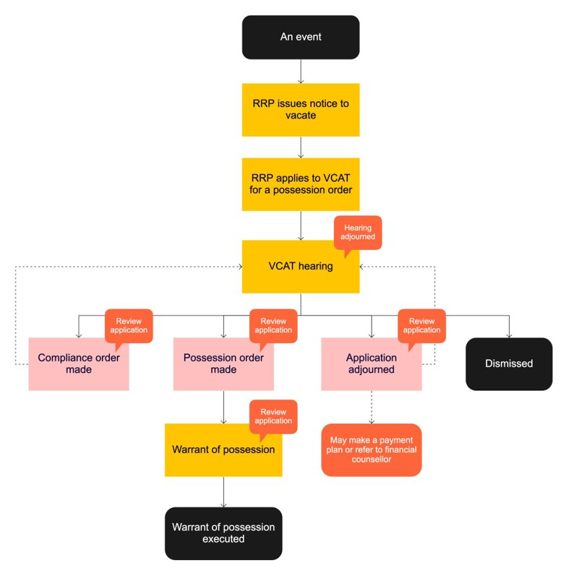

Slide 3
Reasons renters can get a NTV
Non-payment of rent
Illegal use
Non-compliance with Tribunal order
Successive breaches
Repairs/demolition
Rental provider moving in
Property to be sold
Threats and intimidation
End of initial fixed term agreement
Common reasons where NTV can be immediate, but still needs to go to VCAT:
Danger
Damage
Unfit for human habitation
Rental provider can no longer issue a NTV 'without grounds'!

Slide 4
Possession order hearings at VCAT
VCAT must make a possession order if:
The NTV is valid;
The rental provider was entitled to give the NTV; and
It is ‘reasonable and proportionate’ taking into account the impact on:
Rental provider or mortgagee;
Renters and any co-renters or other residents;
Any neighbours or anyone else who may be, or who has been, affected by the renter's acts

Slide 5
The reasonable and proportionate (R&P) test – part 1
The Tribunal must consider these factors:
The nature, frequency and duration of the conduct of the renter, including whether it is a recurring breach of obligations under the rental agreement.
Whether the breach is trivial.
Whether the breach was caused by the conduct of any person other than the renter.
Whether the renter has made an application for an intervention order and whether it was in force, contained an exclusion condition or other matters the Tribunal considers relevant.

Slide 6
The R&P test – part 2
Whether the breach has been remedied as far as is practicable.
Whether the renter has or will soon have capacity to remedy the breach and comply with their obligations under their rental agreement.
The effect of the conduct on others.
Whether any other order or course of action is reasonably available instead of making the possession order.
As the case requires, the behaviour of the rental provider or the rental provider's agent etc.
Any other matter the Tribunal considers relevant.

Slide 7
Lodden Mallee Housing Services Ltd v OBG [2021]
Facts: Rental provider sought possession following violent and intimidating conduct by renter against neighbours, resulting in criminal charges and IVO. Renter had a psychiatric condition which caused the dangerous behaviour. Rental provider operated apartments which they would rent out to vulnerable people at risk of homelessness.
Question: Was it reasonable and proportionate to make a possession order?
VCAT decision: It was not reasonable and proportionate to make a possession order, having regard to:
renter was receiving treatment for psychiatric condition
renter showed signs of improving and was expected to improve further
if renter rendered homeless, treatment would be destabilised.
VCAT ordered application for possession be adjourned to a later date (with rental provider able to renew application if renter failed to comply with set conditions).

Slide 8
Lynch v Manion (Residential Tenancies) [2021]
Facts: Rental provider sought possession as intending to sell property. Renter opposed eviction as she had lived there for 6 years, was a pensioner unable to pay for removalist, and was incapable of moving due to physical and mental health.
Question: Was it reasonable and proportionate to make a possession order?
VCAT decision: It was reasonable and proportionate to make a PO, having regard to:
renter’s physical injuries were not completely prohibitive
renter had few possessions, so move would not be difficult
several cheaper properties available nearby, so renter unlikely to become homeless
while rental provider had no immediate need to sell the premises, had waited 5 months and was entitled to sell
reasonable for rental provider to take advantage of current market to get best price by selling it vacant.

Slide 9
Danrell v Morris (Residential Tenancies) [2022]
Facts: Rental provider sought possession as intending to sell property. Had received advice that a sale with vacant possession would be more attractive to buyers. Renter opposed eviction.
Question: Was it reasonable and proportionate to make a possession order?
VCAT decision: Whilst the NTV was valid, it was not reasonable and proportionate to make a PO, having regard to:
Renter had applied for numerous other properties
Challenges of current rental market and housing crisis
Risk of homelessness for renter if PO granted;
Whilst rental provider needed to sell the property as they were struggling to pay their mortgage, any benefit gained by selling with vacant possession was outweighed by the impact on the renter.

Slide 10
Helping your client at VCAT
You can help clients by providing supporting evidence, including:
if the alleged breach was caused by a person other than your client, evidence of any steps that have been taken to reduce the risk of future breaches (such as police reports, or copies of intervention orders); and
evidence of any important reason that your client remain housed in their current housing. This may the impact if evicted, specialist services that your client or their family utilise in the area, cultural links to the area or modifications made to the home due to disability; and
practical support (providing a quiet room to join teleconference hearing).

Slide 11
VCAT adjournments & rehearings
Adjournments can be requested before or at the hearing but will generally only be granted where there is 'good cause'.
If either party misses the hearing they can lodge a review application, criteria applies.
If there is a warrant for possession a review application can pause the eviction process, act quickly!
QUICK!

Slide 12
Non-payment of rent – five strikes
For the first, second, third or fourth NTVs in a 12-month period*, if the renter pays the arrears owing by the termination date, the NTV doesn’t have any effect.
If the renter does not pay the arrears by the termination date, then the rental provider can apply to VCAT for possession.
At VCAT:
For the first, second, third or fourth NTVs in a 12-month period* - VCAT can adjourn the hearing and refer the renter to financial counselling or make a payment plan.
5th NTV in a 12-month period* - VCAT doesn't have the same options available to make a payment plan or refer to a financial counsellor. VCAT can make a possession order if it is reasonable and proportionate to do so.

Slide 13
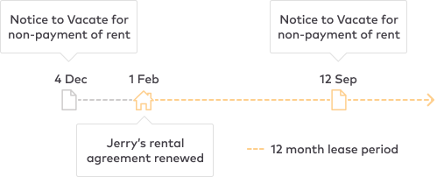
Five strikes - example
Jerry received a Notice to Vacate for non-payment of rent on 4 December 2021.
Jerry’s 12 month rental agreement was renewed on 1 February 2022.
He was given another Notice to Vacate for non-payment of rent on 12 September 2022.
Because Jerry’s lease was renewed on 1 February, only the Notice received in September is relevant. This means that Jerry’s total tally of Notices to Vacate is 1 for the last 12 months of his lease.

Slide 14
Dear Landlord: Self- help for renters behind in the rent
Dear Landlord is our award-winning free self-help tool to help Victorian renters avoid eviction for rent arrears.
Helps renters understand their rights, build confidence and take steps early.
Depending on a help-seekers' responses, Dear Landlord can help draft a letter or email to the landlord/REA asking for a payment plan or help draft a VCAT application if a renter missed a hearing.

Slide 15
Where to get tenancy legal help
Justice Connect Homeless Law
Tenants Victoria
Victorian Aboriginal Legal Service
Victoria Legal Aid
Local community legal centre
Tenancy Assistance and Advocacy Program

Slide 16
VCOSS Renters' Rights Making sense of evictions
22 June 2023

Slide 17
At any given time, there are over 30,000 consumers who are without a home and many consumers facing impending evictions and joining the long queues of trying to find affordable safe accommodation in Victoria. 1 in 4 renters are experiencing rental stress and spending over 30% of their income on rent. So how can a case manager assist a consumer to sustain their tenancy
June 2023

Slide 18
Outline
Introduction
SHSS Programs to assist consumers to stop and prevent consumers from being evicted when they receive a notice to vacate
Individual advocacy and complaints
Private Rental Assistance Program
Housing Establishment funds
Specialist Housing/Homelessness brokerage funds ie: H2H, family violence, and other
Negotiations between landlords and consumers
Payment plan with landlords, real estate agents, and consumers

Slide 19
Introduction
Case managers, IAP workers, support workers and specialist homelessness support workers should have a basic understanding of the residential tenancies act, processes and procedures that would allow them to individually advocate on behalf of consumers who receive notice to vacates and stop any impending evictions.
All case managers in the SHSS should know that there are funding options available to assist consumers to sustain their tenancies
* PRAP, HEF, FV brokerage, and SHSS packages (H2H)

Slide 20
What to do
Understand how the RTA works
Understand the processes and procedures of when a consumer is issued with at notice to vacate and for what reason
Negotiate a payment plan
Access funding from SHSS services to prevent an eviction.
If this all fails and the landlord is to proceed at VCAT contact Justice Connect, Victoria Legal Service or Tenants Victoria for urgent tenancy advice to prevent an eviction

Slide 21
Further information and Assistance
For further information and assistance contact Angela Kyriakopoulos – HAS advocate on 0417 599 610 or angela@chp.org.au
The HAS advocate can provide
Community education on Advocacy and consumer rights and responsibilities in Victoria
Complaints mechanisms in SHSS services and other
Secondary consultations

Slide 22
Thank you.

